Slide 1
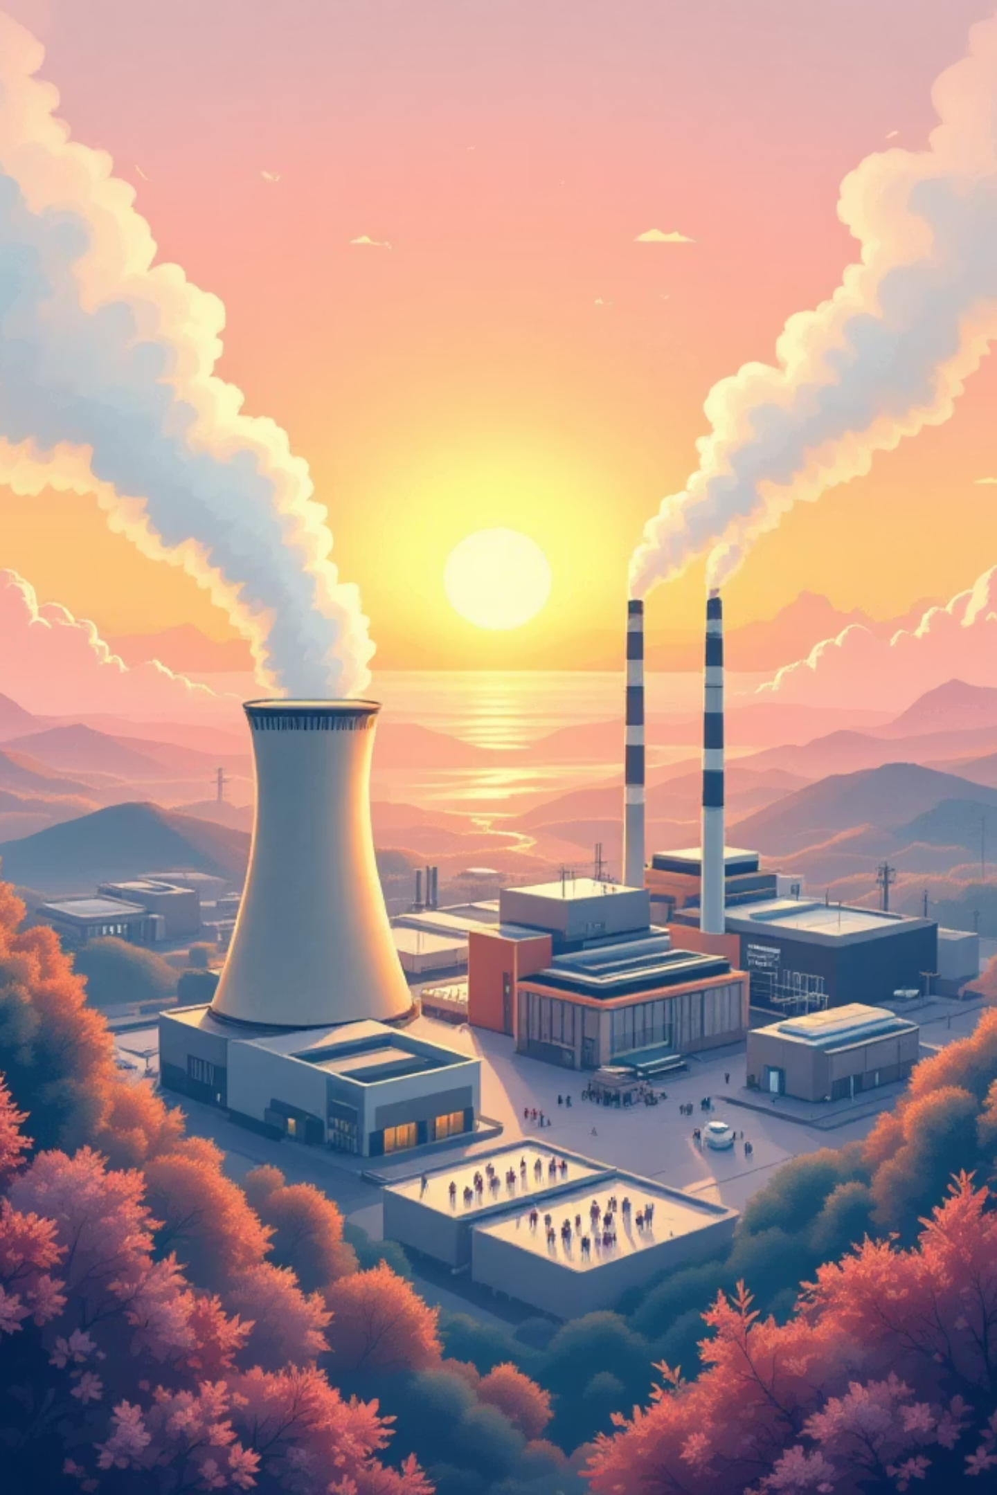
Performance Analysis of an Integrated AD‑HTC Fuel‑Enhanced Gas Combined Cycle
Applied Thermodynamics Project— [Unilag] • [MEG 315]
Presented by Group 2

Slide 2





Team & Contributions
[Agobe Ferdinand]
[Oyibo-Itie Emmanuel]
[Duyile David]
Role: Project Lead, System Modeling & Application Development
Role: Group Member
Role: Group Member
[Osiyale Moriire]
[Fatai Abdullah ]
Role: Group Member
Role: Group Member

Slide 3

Problem Statement & Motivation
The Problem: Conventional systems are inefficient for high-moisture biomass because they require energy-heavy drying, which reduces net energy recovery.
The Solution: We integrated Anaerobic Digestion (AD) for biogas and Hydrothermal Carbonization (HTC) to stabilize wet biomass. And this therefore allows for energy recovery without drying losses.
The Innovation: This hybrid pathway upgrades feedstock to higher gas yields , enabling better turbine integration and increase efficiency.

Slide 4

Objective
To address the challenge of underutilized wet biomass, this project aims to simulate an integrated energy system that recovers maximum value without costly pre-drying.
Our simulation will:
Convert wet biomass through parallel HTC and AD pathways
Combine resulting fuel gases to drive a combined gas-steam power cycle
Calculate power output, efficiency, and fuel production
Identify heat recovery opportunities and optimization targets
Provide an interactive platform for testing variables like moisture content, temperature, and pressure
Expected Outcome: A validated simulation model that demonstrates technical feasibility and guides future pilot-scale development.

Slide 5
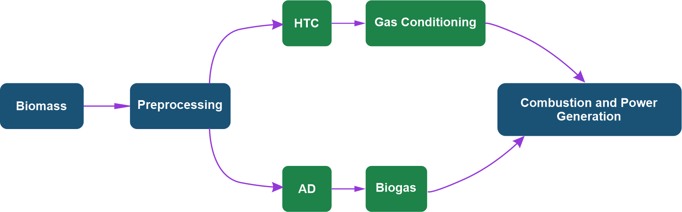
System Overview & Process Flow
Flowchart Summary
Biomass is preprocessed into a slurry, then splits into two parallel paths:
Top: HTC (Hydro-Thermal Carbonization) converts wet biomass to hydrochar → conditioned into fuel gas
Bottom: AD produces biogas like methane from organics
Both gas streams combine and go to Combustion & Power Generation, where a combined gas-steam turbine cycle produces electricity.

Slide 6
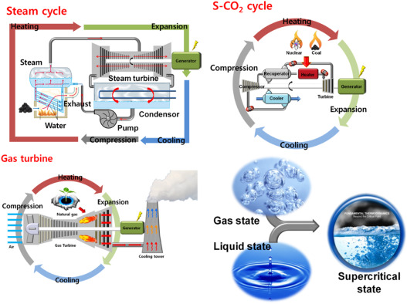
Comparison of Power Cycles: Brayton vs. Rankine
Brayton Cycle (Gas Turbine)
Rankine Cycle (Steam Turbine)
Definition: The Brayton cycle is a thermodynamic power cycle in which air is compressed, heated through constant-pressure combustion, and expanded through a turbine to produce mechanical work. It is the foundation of gas turbine power plants.
Processes
Compression: Ambient air is drawn in and compressed to high pressure
Heat Addition: Fuel is injected and burned in combustion chamber at constant pressure
Expansion: Hot, high-pressure gases expand through turbine to produce work
Exhaust: Spent gases are released to atmosphere (or sent to heat recovery)
Definition: The Rankine cycle is a vapor power cycle in which water is pressurized, heated to steam, expanded through a turbine to generate power, and condensed for reuse. It is the fundamental cycle of steam power plants.
Processes
Pumping: Condensed water is pressurized by pump and fed to boiler
Heat Addition: Water is boiled into high-pressure steam in boiler
Expansion: Steam expands through turbine, converting thermal energy to work
Condensation: Exhaust steam is cooled and condensed back to liquid

Slide 7
Moisture-rich Biomass
Feedstock
Biomass
Feedstock
Biomass
Feedstock
Homogenizer
Boiler
AD
HTC Steam Cycle
Enhanced
Biogas
Collector
Biogas
Distribution to
Building Envelopes
Reactor
Moisture-lean Biomass
Feedstock
Volatile Matters
and Feedstock Waste
Biogas Combustion
chamber
System Schematic
Compressor
Turbine
AD-HTC Fuel-Enhanced
Gas Power Cycle
Air
Exhaust Gases

Slide 8

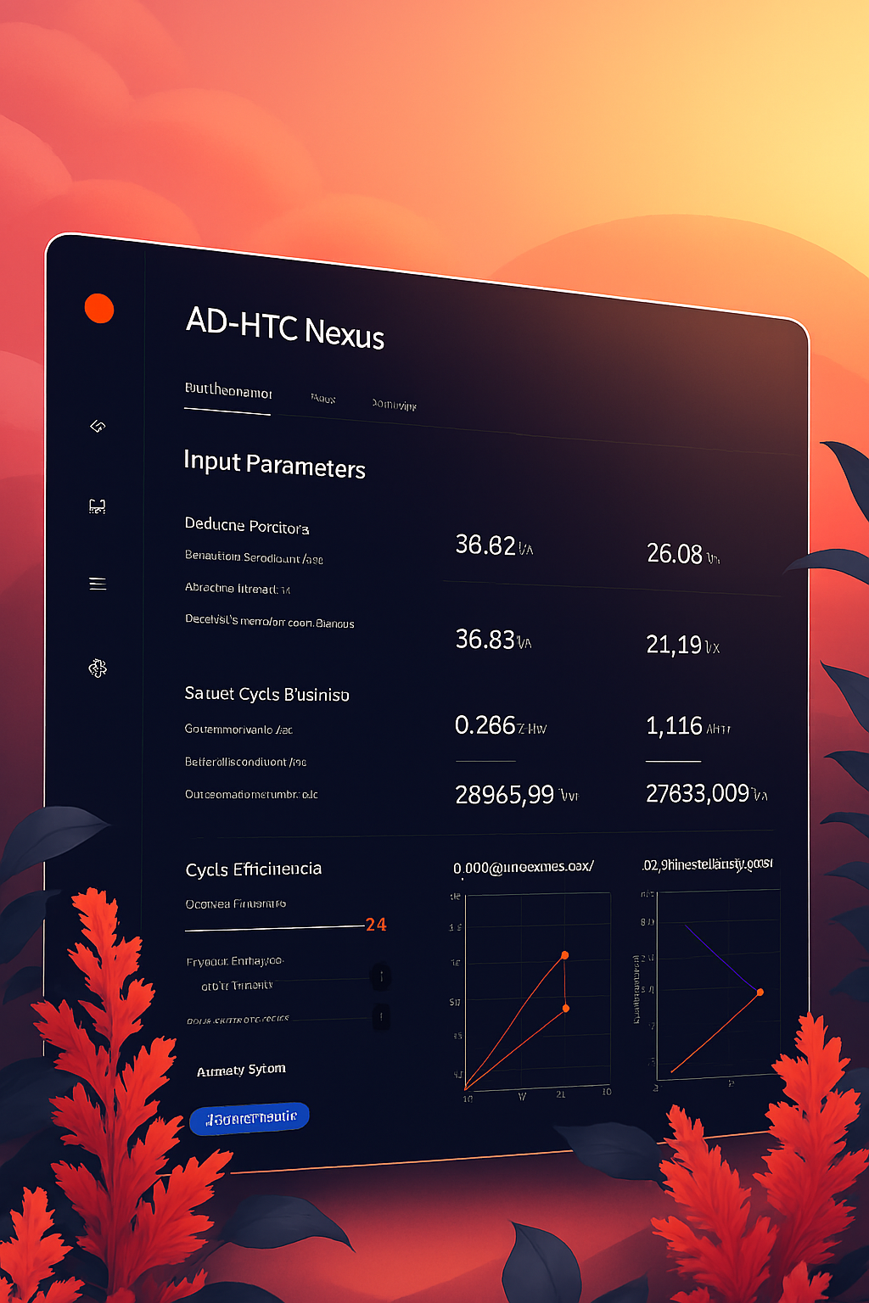
Web Application Demo — Simulation Interface
Live simulation UI showing input controls, parameter panels, and result widgets (power, efficiency, consumption).
INPUTS
Biomass flow rate,
moisture content,
lower heating value (LHV),
boiler and condenser pressures,
turbine efficiency, compressor
pressure ratio, compressor
efficiency, and turbine
inlet temperature.
OUTPUTS
Total power (Brayton, Rankine,
combined), cycle efficiencies,
fuel consumption, energy
flow analysis (useful work
and losses), and AD‑HTC gas
yields (Gas A, Gas B, methane,
HTC heating load).

Slide 9


Acknowledgement
We sincerely acknowledge the guidance and
technical supervision of Dr Ogedengbe and the department for
their unwavering support throughout this project. Special appreciation goes to our group members for their dedication,
teamwork, and collective effort in developing this project. Each contribution was
valuable in achieving our objectives. We are grateful for the collaboration and shared
commitment that made this work possible.

Slide 10
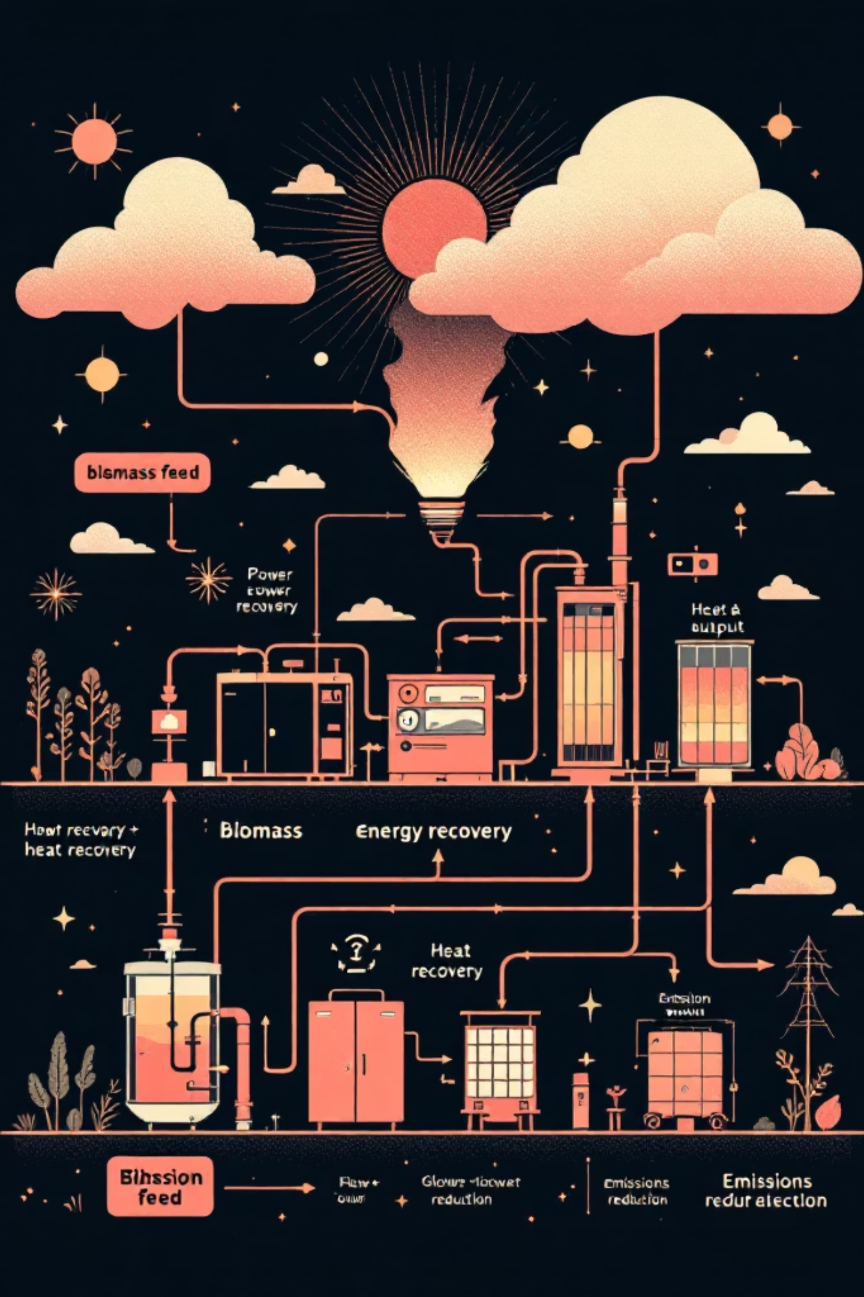
Conclusion — Key Takeaways
What we did
We simulated a system that turns wet biomass into electricity using
HTC AND AD together
Why it Works
It handles wet waste without drying, recovers energy at multiple stages,
And produces useful fuel from two parallel pathways.
What’s Next
Refine the simulation with real data, explore better heat recovery, and
Assess whether it makes sense to scale up
🔗 Access the Project:
Live App: https://klassiq901-ad-htc-biomass-simulator-app-grofpr.streamlit.app/
GitHub Repository: https://github.com/Klassiq901/AD-HTC-Biomass-Simulator

